Slide 1
Fetch decode execute cycle
Fetch :
Get an instruction from main memory
Decode:
Translate it into computer command
Execute:
Actual processing of command
Store/Write back:
Write result to memory.

Slide 2
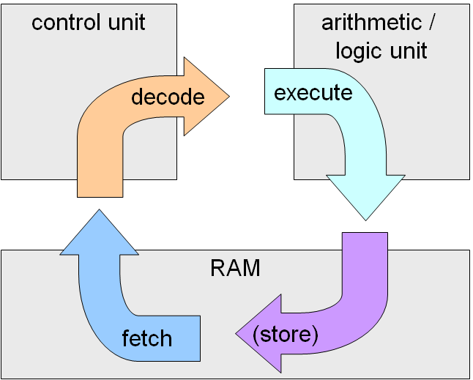
Fetch decode execute cycle

Slide 3
The Fetch/Execute Cycle
“Instruction Execution Engine”…a machine that cycles through a series of operations
Series is called: Fetch/Execute Cycle
Get the next instruction
Figure out what to do
Gathering the data needed to do it
Do it
Save the result, and
Repeat (billions of times/second)!

Slide 4
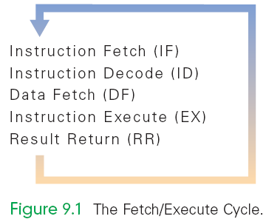
A Five-Step Cycle
These operations are repeated in a never-ending sequence
A five-step cycle:
Instruction Fetch (IF)
Instruction Decode (ID)
Data Fetch (DF) / Operand Fetch (OF)
Instruction Execution (EX)
Result Return (RR) / Store (ST)

Slide 5
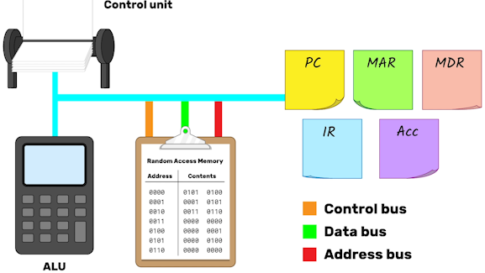
A Five-Step Cycle

Slide 6
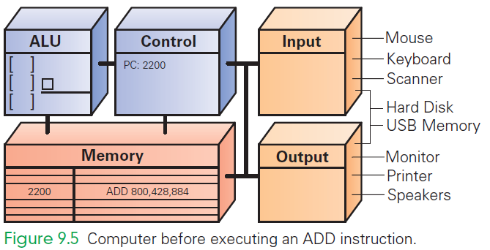
ADD 800, 428, 884

Slide 7
Instruction Fetch (IF)
Execution begins by moving the instruction at the address given by the (PC 2200) from memory to the control unit
Once instruction is fetched, the PC can be changed for fetching the next instruction

Slide 8
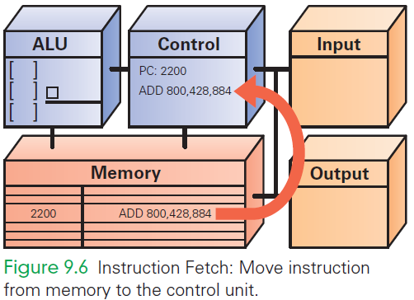
IF
Notes:
Execution begins by moving the instruction at the address given by the PC (PC 2200) from memory to the control unit
Once instruction is fetched, the PC can be readied for fetching the next instruction

Slide 9
Instruction Decode (ID)
ALU is set up for the operation
Decoder finds the memory address of the instruction's data (source operands)
Most instructions operate on two data values stored in memory (like ADD), so most instructions have addresses for two source operands
These addresses are passed to the circuit that fetches them from memory during the next step
Decoder finds the destination address for the Result Return step and places the address in the RR circuit
Decoder determines what operation the ALU will perform (ADD), and sets up the ALU

Slide 10
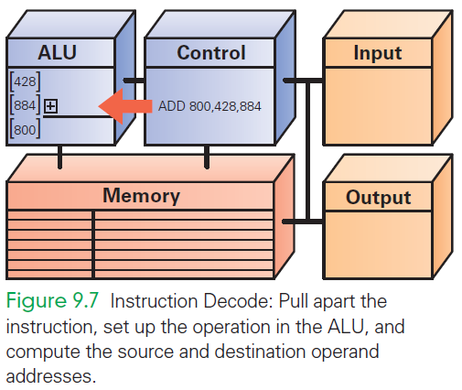
ID

Slide 11
Data Fetch (DF)
The data values to be operated on are retrieved from memory
Bits at specified memory locations are copied into locations in the ALU circuitry
Data values remain in memory (they are not destroyed)

Slide 12
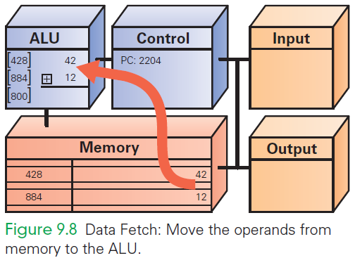
DF

Slide 13
Instruction Execution (EX)
For this ADD instruction, the addition circuit adds the two source operands together to produce their sum
Sum is held in the ALU circuitry
This is the actual computation

Slide 14
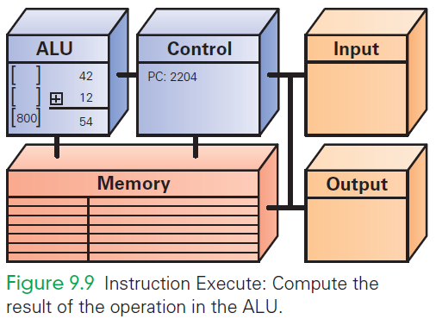
EX

Slide 15
Return Result (RR)
RR returns the result of EX to the memory location specified by the destination address.
Once the result is stored, the cycle begins again

Slide 16
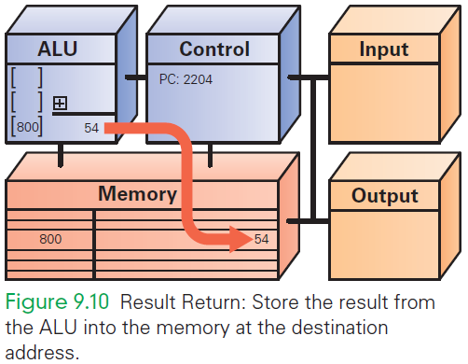
RR

Slide 17
Cycling the Fetch/Execute Cycle
ADD is representative of the complexity of computer instructions…some are slightly simpler, some slightly more complex
Computers achieve success at what they can do with speed.
They show their impressive capabilities by executing many simple instructions per second

Slide 18
Many, Many Simple Operations
Computers “know” very few instructions
The decoder hardware in the controller recognizes, and the ALU performs, only about 100 different instructions (with a lot of duplication)
There are only about 20 different kinds of operations.
Everything that computers do must be reduced to some combination of these primitive, hardwired instructions

Slide 19
Processor and Memory

Slide 20
Memory
Memory stores both the program while it is running and the data on which the program operates
Properties of memory:
Discrete locations
Memory is organized as a sequence of discrete locations
In modern memory, each location is composed of 1 byte (8 bits)

Slide 21
Memory
Addresses
Every memory location has an address, whole numbers starting at 0
Values
Memory locations record or store values
Finite capacity
Memory locations have a finite capacity (limited size),
Data may not “fit” in the memory location

Slide 22
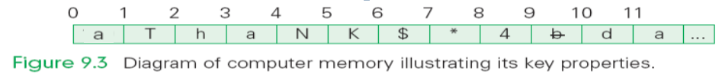
Byte-Size Memory Location
Common visualization of computer memory
Discrete locations are shown as boxes holding 1-byte each
Address of location is displayed above the box and the contents of location is shown in the box

Slide 23
Byte-Size Memory Location
That 1-byte memory location can store one ASCII character or a number less than 256
Blocks of four bytes are used as a unit so often that they are called memory words.

Slide 24
RAM
Computer memory is called random access memory (RAM)
“Random access” is out-of-date and simply means that the computer can refer to the memory locations in any order
RAM is measured in megabytes (MB) or gigabytes (GB)
Lots of memory is need to handle the space required of programs and data

Slide 25
Storage Evaluation Criteria
Property | Desirable | Primary storage | Secondary storage
Storage capacity | Large storage capacity | Small | Large
Access Time | Fast access time | Fast | Slow
Cost per bit of storage | Lower cost per bit | High | Low
Volatility | Non-volatile | Volatile | Non-volatile
Access | Random access | Random access | Pseudo-random access or sequential access

Slide 26
Memory Capacity
Memory capacity of a computer is equal to the number of bytes that can be stored in its primary storage
Its units are:
Kilobytes (KB) : 1024 (2¹⁰) bytes
Megabytes (MB) : 1,048,576 (2²⁰) bytes
Gigabytes (GB) : 1,073,741824 (2³⁰) bytes

Slide 27
Control unit-CU
The control unit of a computer is where the Fetch/Execute Cycle occurs
Its circuitry fetches an instruction from memory and performs the other operations of the Fetch/Execute Cycle on it
A typical machine instruction has the form ADD 4000, 2000, 2080

Slide 28
Task
ADD 4000, 2000, 2080
Looks like those three numbers should be added together
What it really means is that whatever numbers are stored in memory locations 2000 and 2080 be added together, and the result be stored in location 4000

Slide 29
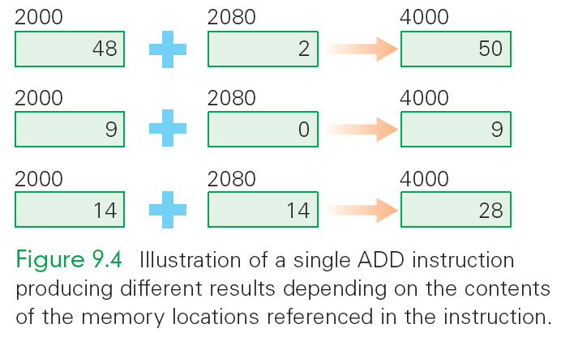
task

Slide 30
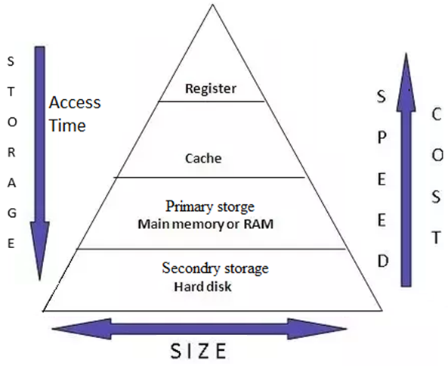
Storage Hierarchy
Capacity and access are inversely proportional to each other

Slide 31
The Program Counter (PC)
How does the computer determine which instruction it should execute next?
Address of the Next Instruction
The instruction is stored in memory and the computer has its address
Computers use the address (known as the program counter or PC) to keep track of the next instruction

Slide 32
The Computer Clock
Computers are instruction execution engines.
Since the computer does one instruction per cycle in principle, the speed of a computer depends on the number of Fetch/Execute Cycles it completes per second.

Slide 33
The Computer Clock
The rate of the Fetch/Execute Cycle is determined by the computer’s clock, and it is measured in megahertz, or millions (mega) of cycles per second (hertz).
A 1,000 MHz clock ticks a billion (in American English) times per second, which is one gigahertz (1 GHz)

Slide 34
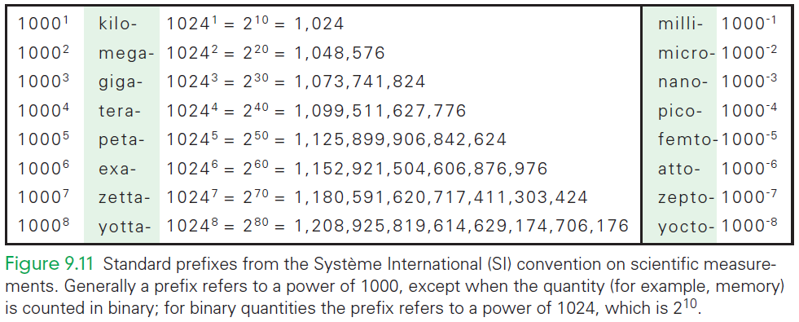
Standard Prefixes

Slide 35
One Cycle per Clock Tick
A computer with a 1 GHz clock has one billionth of a second—one nanosecond—between clock ticks to run the Fetch/Execute Cycle.
In that amount of time, light travels about one foot (~30 cm).
Modern computers try to start an instruction on each clock tick.

Slide 36
Computer’s View of Software
Once installed, the computer runs the software by:
copying the binary instructions into the RAM
interpreting them using the Fetch/Execute Cycle.
It does whatever the instructions tell it to do

Slide 37
Processor Speed
Computer has a built-in system clock that emits millions of regularly spaced electric pulses per second (known as clock cycles)
It takes one cycle to perform a basic operation, such as moving a byte of data from one memory location to another
Normally, several clock cycles are required to fetch, decode, and execute a single program instruction
Hence, shorter the clock cycle, faster the processor
Clock speed (number of clock cycles per second) is measured in Megahertz (10⁶ cycles/sec) or Gigahertz (10⁹ cycles/sec)

